Slide 1
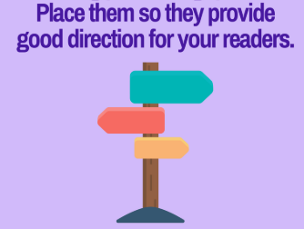
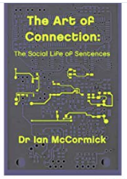
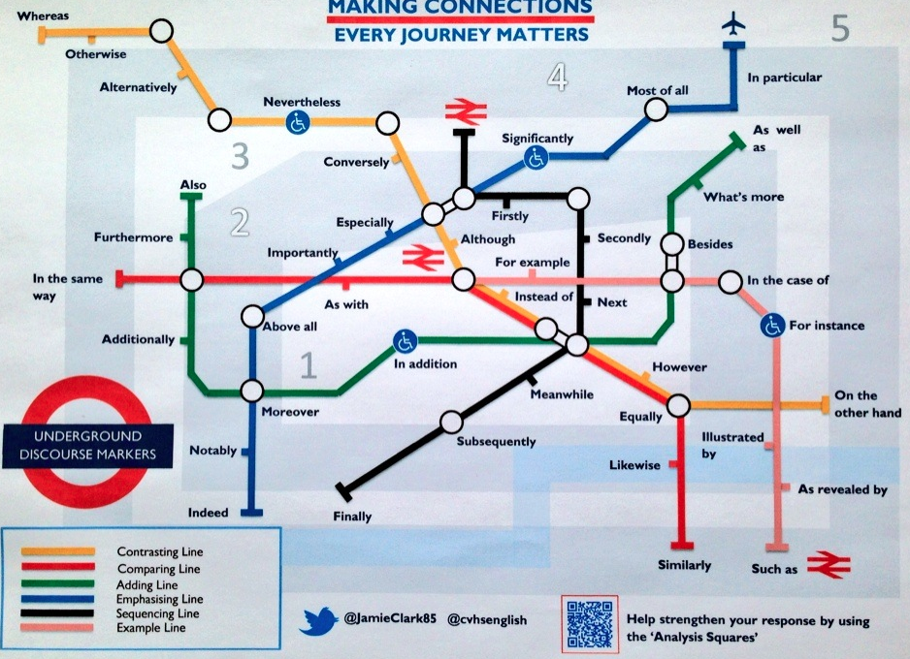
SILENT STARTER:
What might a discourse marker be?
Write your own definition. 5 mins
What would you choose to symbolize a discourse marker?

Slide 2
ESTABLISH:
TITLE: DISCOURSE MARKERS
LO: TBAT use discourse markers successfully.

Slide 3
Notes:
How does this map help you to understand how discourse markers work? Class discussion.

Slide 4
Connectives/Discourse markers:
Discourse markers plot your narrative for you. They let the reader navigate their way through a text with ease.
Discourse markers are words that connect ideas.
Discourse markers signpost the reader through your thoughts, idea and opinions.
1
2
3
Notes:
Choose the definition you most think accurately describes the job of a discourse marker. Think-pair-share your choice. Can you find agreement? Think-pair-share-square. Are we still in agreement?

Slide 5
Discourse markers to further improve essay writing:
Adding: and, also, as well as, moreover, too, furthermore
Cause & effect: because, so, therefore, thus, consequently
Sequencing: next, then, first, finally, meanwhile, before, after
Qualifying: however, although, unless, except, if, as long as, apart from, yet
Emphasising: above all, in particular, especially, significantly, indeed, notably
Illustrating: for example, such as, for instance, as revealed by, in the case of
Comparing: equally, in the same way, similarly, likewise, as with, like
Contrasting: whereas, instead of, alternatively, otherwise, unlike, on the other hand
Notes:
For reference/printing.

Slide 6
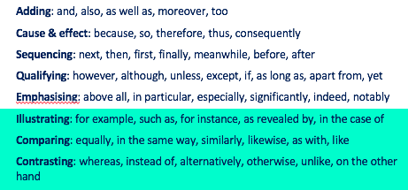
REVIEW
Which three discourses markers do you think are the most effective? Why?

