Slide 1
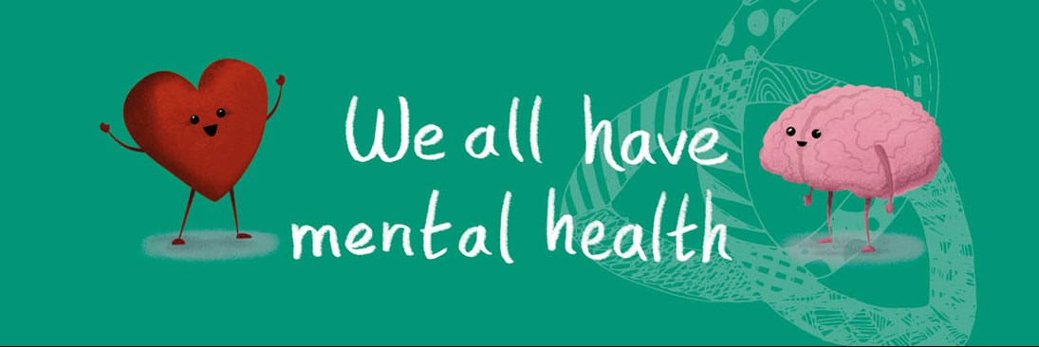
During home learning, social distancing or self-isolation, pay attention to your own wellbeing and that of those around you.

Slide 2
Remember we are all part of the school community
Keep in regular contact with your teachers, at your regular lesson times.
Remember you are not alone. Your teachers are still available to support you, both academically and pastorally.
Ask for help when needed; independent learning is a new skill to learn. Don’t be afraid to say if something seems confusing or you need extra support.
Try to keep on top of your workload to avoid feeling overwhelmed.
Take the opportunity to also follow your passions; if a particular topic interests you, research it. You never know where it might lead! Be sure to keep your teachers updated so we can support you in this.

Slide 3
What wellbeing looks like
Interactions with family and friends
Healthy eating
Regular sleep patterns
Communicates with others
Work/ life balance
Other interests
Physical activity
All of these remain important during the period of home learning.
Notes:
Change in appearance: weight loss or gain, lack of self care, skin tone

Slide 4
Signs and symptoms to look out for
Change in sleep patterns
Becoming withdrawn
Friendship groups: can become less or more social than usual
Change in eating patterns
Change in appearance
Personality shifts
Problems with concentration

Slide 5
Wellbeing: What Parents/ Carers Can Do?
Healthy eating
Encourage down-time
Create productive habits – work routines
Interactions/ listening
Good home/ school communication
Monitoring social media access
Be aware of important academic dates
No issue is too small!

Slide 6
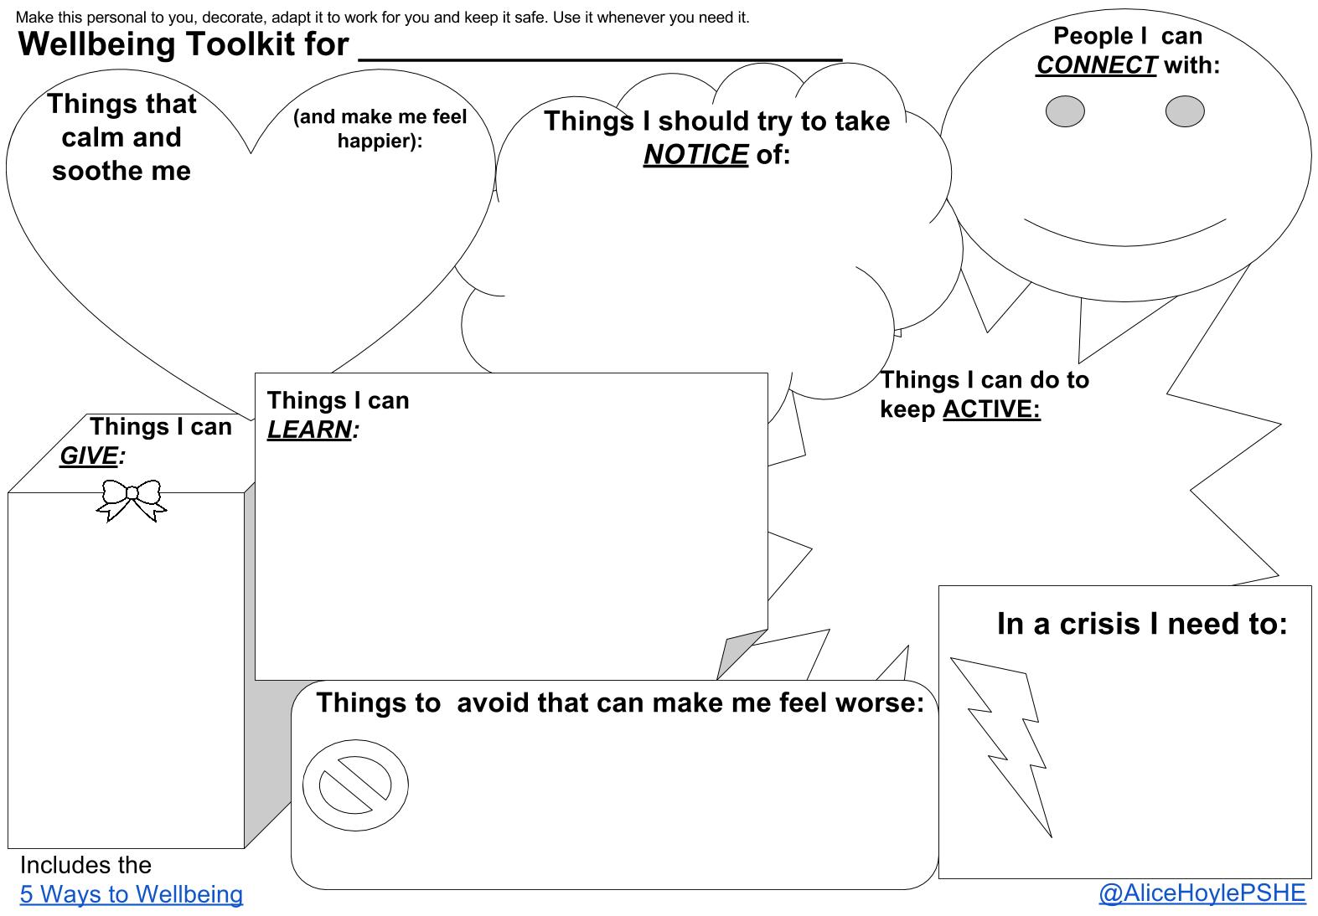

Slide 7
Build in structure

Slide 8
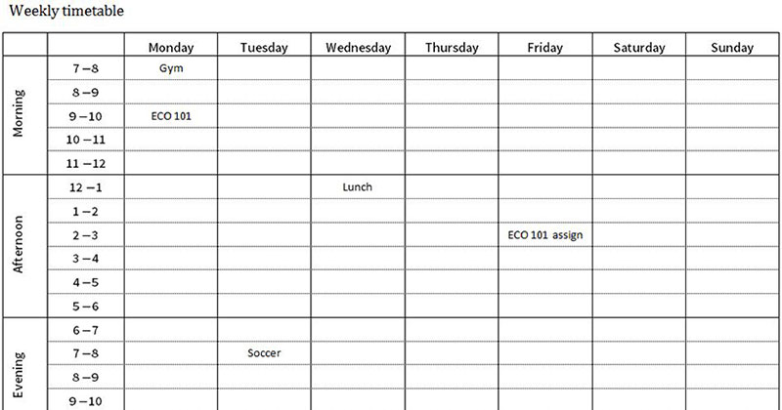
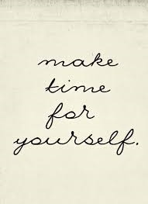
Build in structure
Try to maintain a routine similar to your normal day/ week (eg, weekday and weekend routines)
Have allocated time for work and for rest
Maintain habits – dress in the daytime, etc
Make time for what you love
Break your day/ week into chunks
Plan your time
Build in social contact; distance physically but don’t become socially isolated

Slide 10
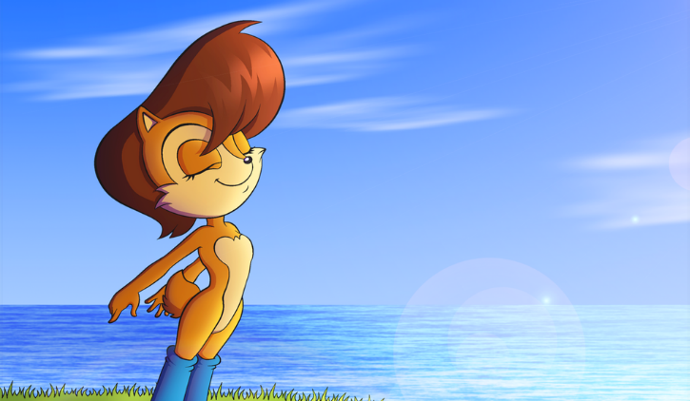
Remember the basics

Slide 11
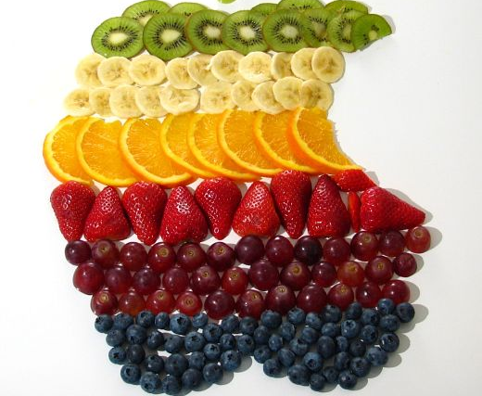
Basics
Get some fresh air*
Go outside, preferably in the mornings/ during daylight*
Exercise at regular points throughout the day. Keep hydrated
Try to maintain regular meal-times
Eat a balanced diet
*If it is safe to do so and bearing in mind any medical advice.

Slide 12
Stay Connected
Physical distancing – not social distancing

Slide 13
Stay Connected
Make time to connect with family and friends online or virtually
Schedule regular catch ups – use Whatsapp, Facetime or Messenger Video calls
Make plans to “meet” – video calls for meals, cake, takeaways, etc
Use appropriate technology wisely (eg Netflix watch parties, gaming apps with chat function) but safely and only with your own existing social circle
Be kind – remember others may also be finding this situation challenging

Slide 14
Know where to go for extra help if you need it

Slide 15
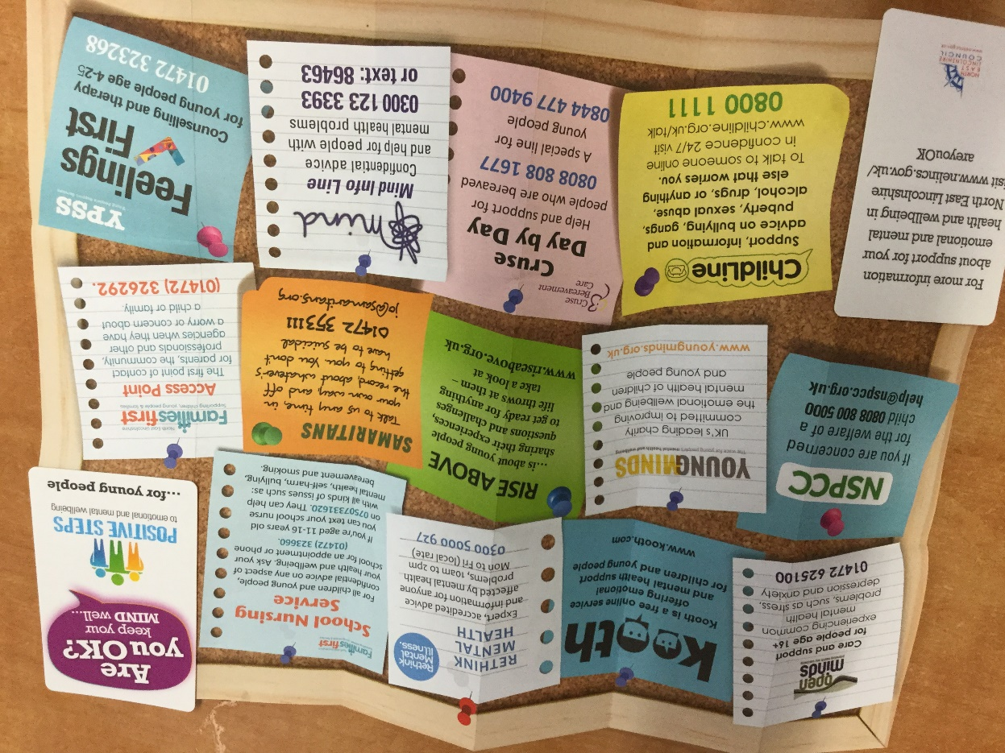
Where to go for help – some ideas

Slide 16
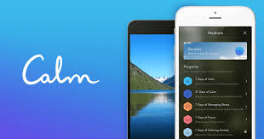
Tools and resources
Youtube – lots of guided meditations and mindfulness videos, music for relaxation/ concentration
Kooth app – online counselling and emotional well-being platform for children and young people, accessible through mobile, tablet and desktop
Calm app – guided meditations, daily reminders. School subscription.
BBC – specific programmes, podcasts and online resources to support pupils and parents during school closures

Slide 17
Keep moving

Slide 18
Keep Moving
Your daily activity will be reduced if you are at home, so it is important to build movement into your routine
Your usual exercise method may no longer be available
Use this opportunity to try something different
Youtube and other apps have tutorials and guided workouts
Try HIIT (High Intensity Interval Training), or more gentle exercises such as Yoga or Pilates
Go outside into the garden and play a game*
Take care not to injure yourself – work within your usual fitness levels and take it steady

Slide 19
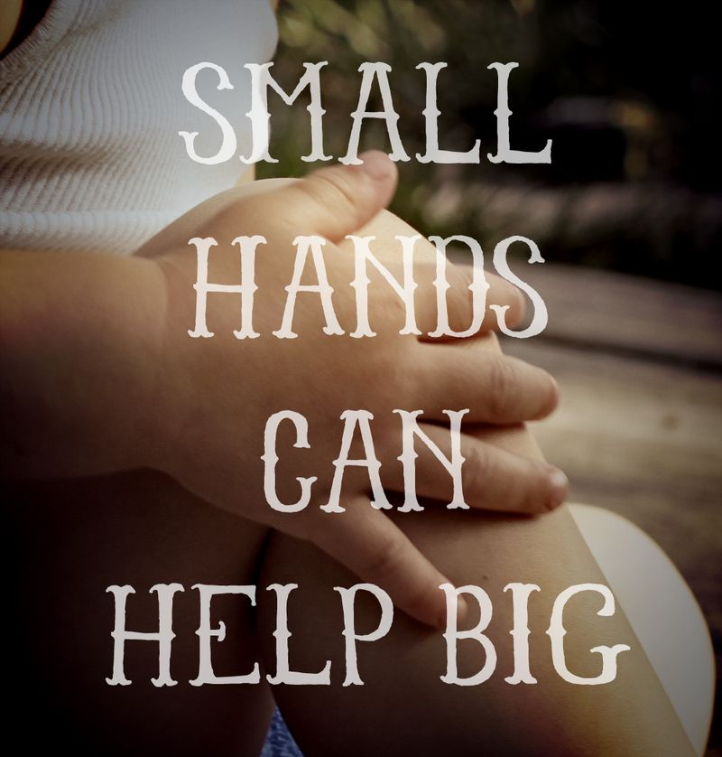
Make time meaningful

Slide 20
Make your time meaningful
All those things you never seem to have time for – list them!
Take up a new skill or hobby
Make time to be creative – art, music, crafts etc.
Make time to help others where possible, either virtually or, where safe to do so, in person; collect some shopping for a neighbour, offer to do some gardening for someone nearby, etc.
Keep up to date with study so you don’t feel overwhelmed

Slide 21
Mindful mandalas

Slide 22
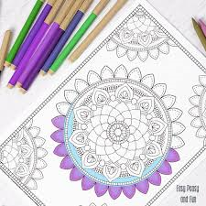
Mandalas/ mindful colouring benefits
Creative activities encourage flow
Slows breathing and heart rate
Allows self-expression
Time together
Can encourage “accidental” conversations
Provides a mental pause

Slide 23
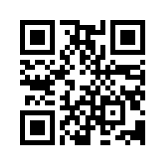
Try it… scan here for a link to mandala colouring ideas and downloads
Good things take time.

Slide 24
Music for relaxation and focus

Slide 25
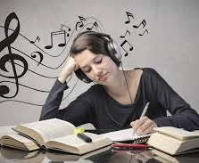
Music - benefits
Can reduce distractions
Sets a mood for concentration or relaxation
Can build routines
Reduces anxiety

Slide 26
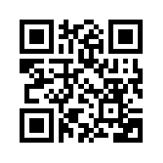
Try it… scan here for a link to music for relaxation
Everything is better with music.

Slide 27
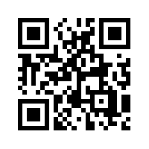
Try it… scan here for a link to Spotify playlists for focus
Music is what feelings sound like.

Slide 28
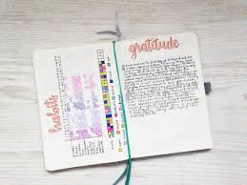
Journals and writing for wellbeing

Slide 29
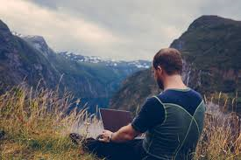
Journaling - benefits
Helps process emotions
Allows self-expression
Reduces stress and anxiety
Improves self-awareness

Slide 30
Journaling prompts – some ideas
The main thought in my head today was…
Right now I feel challenged by…
I feel supported when…
I am grateful for…
One thing I could do to help myself today is…
What I want to say to my anxious thoughts…
Write your anxious thoughts that include words like “never,” “always,” “everyone,” and “no one.” Circle those you can prove are 100% true

Slide 31
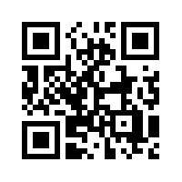
Try it…
scan here for a link to journaling ideas
Fill the paper with the breathings of your heart.
William Wordsworth

Slide 32
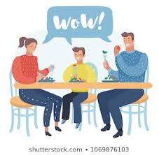
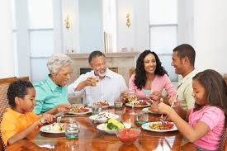
Keep talking

Slide 33
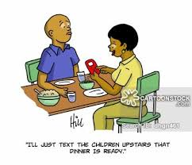
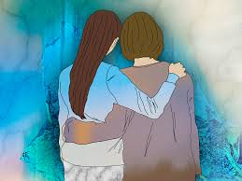
Talking - benefits
Improves relationships
Identifies potential problems early
Builds self-esteem
Generates problem-solving ideas together

Slide 34
Who did you eat lunch with today?
What is your favourite song right now? Why?
What has made you smile/ frustrated/ confused today?
Has anyone around you had a hard time today?
If you could do anything this weekend/ next holiday, what would you choose?
What are you most looking forward to right now?

Slide 35
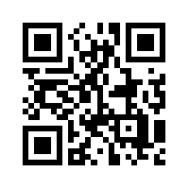
Try it…
scan here for a link to conversation starters.
Every good conversation starts with good listening.

